Slide 1


Slide 2
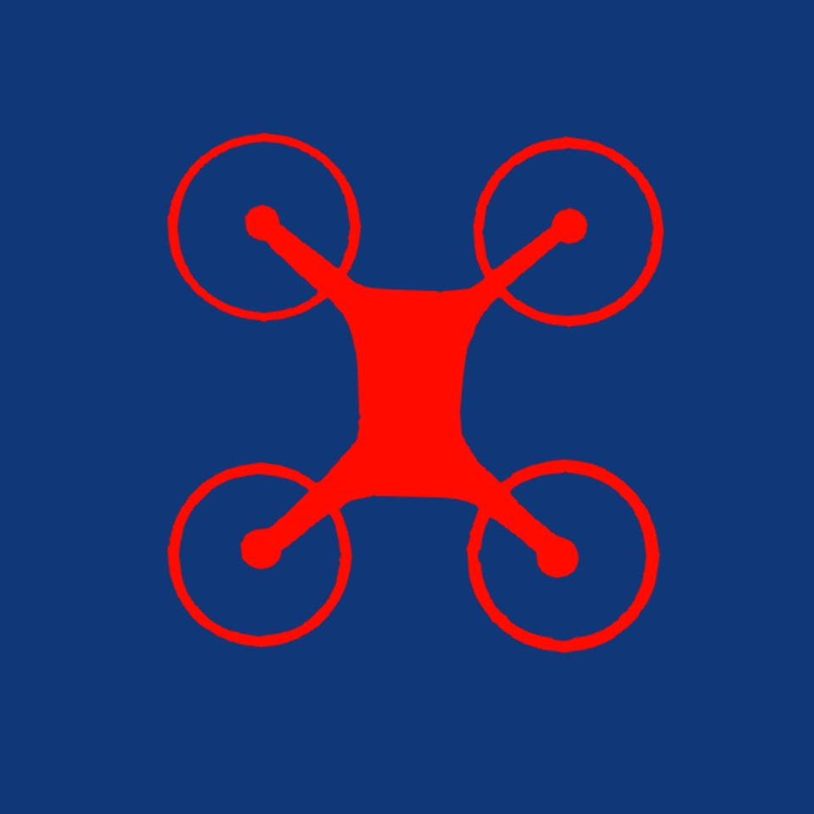
Drone Air Activities 3
Instructor Name
Instructor Appointment
Queensland Group

Slide 3
Assessment:
100 total possible marks, of which;
70 are from a theory final assessment;
10 are from the workbook progress questions;
20 are from the Flight Test (Section 9).
The pass mark for the course is 50%
Queensland Group

Slide 4
This Course will cover:
What is a Drone?
History of Drones
Uses of Drones
Main parts of a Drone
Theory of Drone flight (fixed wing & multi-rotor)
Drone maintenance
CASA Regulations (Drone flying and Airspace)
Queensland Group

Slide 5
What is a Drone?
History of Drones
Uses of Drones
Main parts of a Drone
Theory of Drone flight (fixed wing & multi-rotor)
Drone maintenance
CASA Regulations (Drone flying and Airspace)
Queensland Group

Slide 6
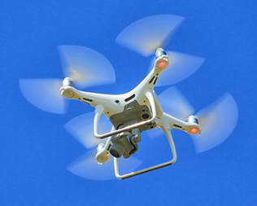
What is a Drone?
In aviation & space a Drone is:
Aerial vehicle
No on-board human pilot
Remote or autonomously
Also known as:
Unmanned Aerial Vehicles (UAVs)
Unmanned Aerial Systems (UAS)
Remotely Piloted Aircraft Systems (RPAS)
Queensland Group

Slide 7
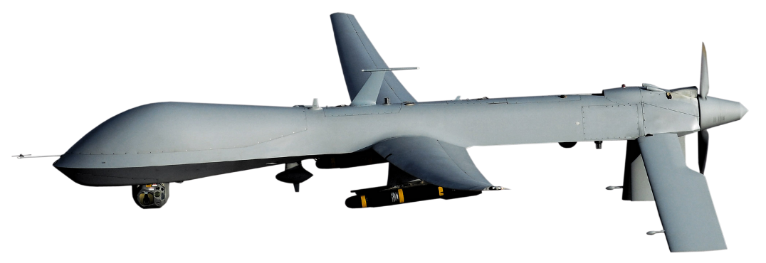
What is a Drone?
Original purpose:
Dull/dangerous work
Military – then increasingly civilian
More civilian now than military
RESEARCH TOPIC:
How many drones are currently being used in Australia?
Queensland Group
Notes:
In January 2019 there were estimated to be more than 100,000 drones in Australia
(source: https://ia.acs.org.au/article/2019/drone-industry-welcomes-tighter-rules.html)

Slide 8
What is a Drone?
Categories:
Multirotor
Fixed-wing
Tilt wing
Queensland Group
Notes:
In January 2019 there were estimated to be more than 100,000 drones in Australia
(source: https://ia.acs.org.au/article/2019/drone-industry-welcomes-tighter-rules.html)

Slide 9
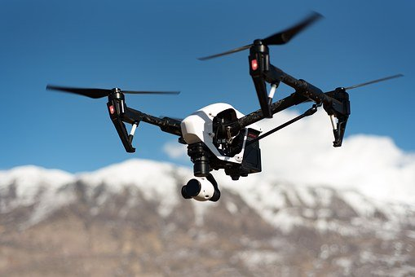
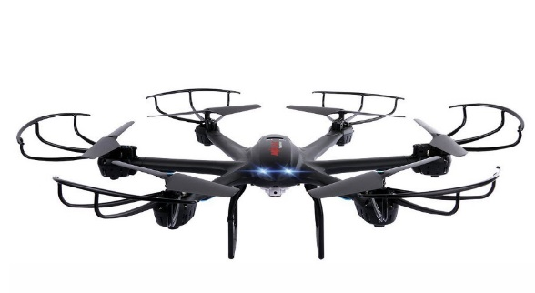
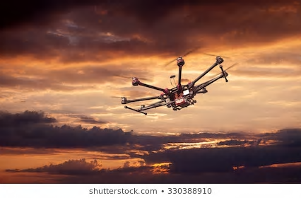
What is a Drone?
Multirotors:
Have many propellers
Can hover
Can manoeuvre more quickly and efficiently
Types include:
Quadrotor
Hexacopter
Octocopter
https://pixabay.com/images/search/drone/
Queensland Group

Slide 10
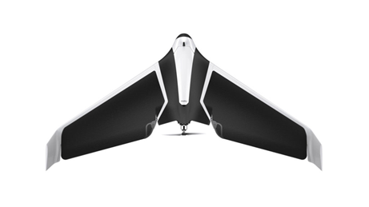
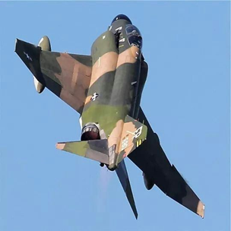
What is a Drone?
Fixed-wing:
Similar to an airplane
Simpler structure
Can fly longer
Can fly faster
Can carry heavier payloads
Use less power
COMPARE THE IMAGES - Similarities & differences?
Queensland Group

Slide 11
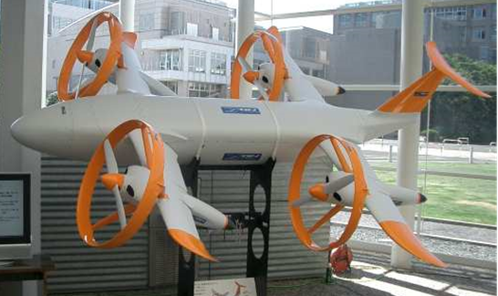
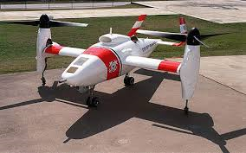
What is a Drone?
Tilt-wing:
Combine the benefits of multirotor and fixed wing
Vertical take off that can transition to forward flight.
Complicated design
Queensland Group

Slide 12
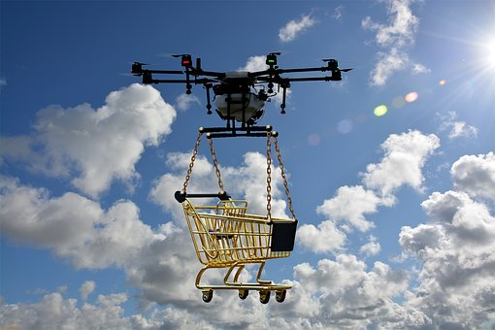
Progress questions
https://pixabay.com/images/search/drone/

Slide 13
What is a Drone?
History of Drones
Uses of Drones
Main parts of a Drone
Theory of Drone flight (fixed wing & multi-rotor)
Drone maintenance
CASA Regulations (Drone flying and Airspace)
Queensland Group

Slide 14
When were drones first used?

Slide 15
Let’s look at the history…
First use in 1806:
  UAV
  Royal Navy
  Kites dropping propaganda leaflets
1849:
  Balloons
  Bombs with timed fuses
Early focus was on military applications
Queensland Group

Slide 16
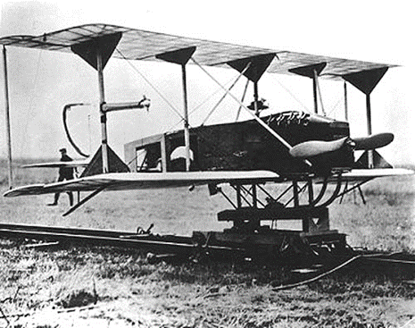
Let’s look at the history…
1916:
  Ruston Proctor Aerial Target
  Used emerging revolutionary radio control techniques
  World’s first pilotless aircraft
1916-1918:
  Hewitt-Sperry Automatic Plane
  Same use of RC technology
  Included gyros, barometer, servos & distance measuring equipment
https://en.wikipedia.org/wiki/Hewitt-Sperry_Automatic_Airplane
Queensland Group

Slide 17
Let’s look at the history…
1918:
  Kettering Bug
  Experimental aerial torpedo
1930’s :
  De Havilland Queen Bee
  Low cost, remote controlled
  Training for anti-aircraft gunnery
  Could be re-used (if it survived!)
  Based on the Tiger Moth aircraft
Queensland Group

Slide 18
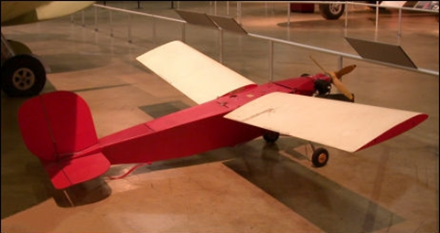
Let’s look at the history…
1940:
  OQ-2 Radioplane
  Sold to US Army
  First mass-produced drone in the US
Post 1945:
  Out of sight RC control developed
  Reconnaissance during the Vietnam War
  First commercial applications in Japan during 1980s
  Use in modern warfare (including in combat)
https://en.wikipedia.org/wiki/Radioplane_OQ-2
Queensland Group

Slide 19

Progress questions

Slide 20
What is a Drone?
History of Drones
Uses of Drones
Main parts of a Drone
Theory of Drone flight (fixed wing & multi-rotor)
Drone maintenance
CASA Regulations (Drone flying and Airspace)
Queensland Group

Slide 21
Why use a drone?
Improving technology
lower costs
More accessible
Flexibility
Reduce risk to humans

Slide 22
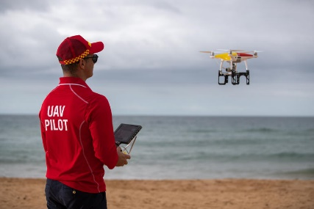
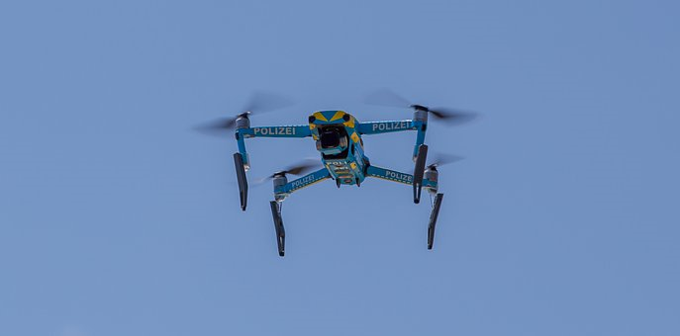

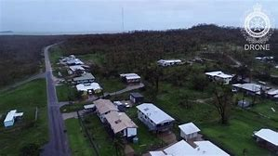
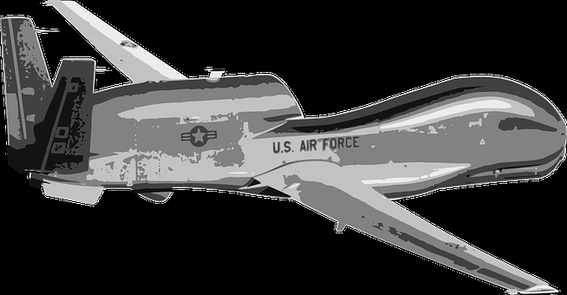
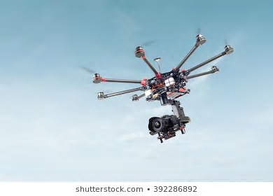
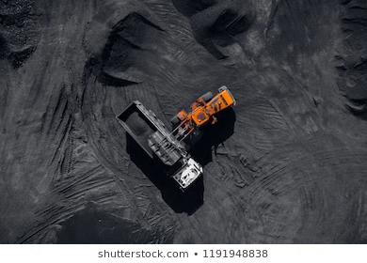
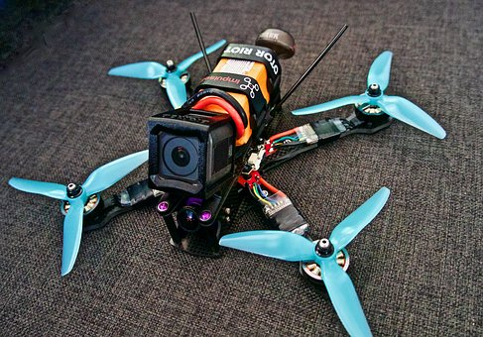
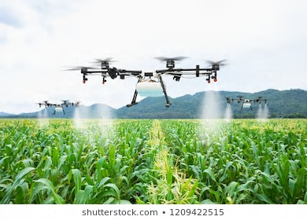
Organisations that use drones
Surf Life Saving Australia
Infrastructure
Emergency Services
Military
QFES
Media & Entertainment
Mining
FPV Drone Racing
Agriculture
Queensland Group

Slide 23
Organisations that use drones
Infrastructure
Inspecting:
  Roads
  Railways
  Energy
  Oil & gas
Queensland Group

Slide 24
Organisations that use drones
Emergency Services
Go into dangerous places
Work too dangerous for people
ID & track criminal activities
Queensland Group

Slide 25
Organisations that use drones
QFES
Assess situations
  Bushfires
  Natural disasters
Quickly assess damage
No risk to operator
Queensland Group

Slide 26
Organisations that use drones
Surf Life Saving Australia
Monitor beaches
Plans to drop buoyancy devices to swimmers
Information:
  Rips
  Sharks
  Swimmers in trouble
Queensland Group

Slide 27
Organisations that use drones
Military
Used extensively
Protect lives
Live video surveillance
Reconnaissance
Tracking
Real-time information
Direct combat roles
Queensland Group

Slide 28
Organisations that use drones
Soil & field analysis
Planting
Crop spraying
Crop monitoring
Irrigation
Crop health assessments
Future?
  Swarms collectively monitoring
  Hybrid air-ground drones
Agriculture
Queensland Group

Slide 29
Organisations that use drones
Mining
Untapped potential
Dangerous and monotonous work
More cost effective and versatile than helicopters
Can check mine safety for humans
Queensland Group

Slide 30
Organisations that use drones
Media & Entertainment
Film-making
Aerial photography and filming
Advertising
Entertainment shows
  Travel programs
  Documentaries
Special effects
Queensland Group

Slide 31
Organisations that use drones
FPV Drone Racing
First Person View/Video
Sport
Racers control drones
Head mounted displays
Live video stream
Began in 2013/14
Queensland Group

Slide 32
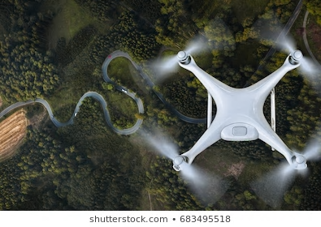
Progress questions

Slide 33
What is a Drone?
History of Drones
Uses of Drones
Main parts of a Drone
Theory of Drone flight (fixed wing & multi-rotor)
Drone maintenance
CASA Regulations (Drone flying and Airspace)
Queensland Group

Slide 34
Main parts of a drone
Queensland Group

Slide 35
Main parts of a drone
Frame or chassis:
Skeleton of drone
Range of weights/sizes
Frequently a ‘basic X’ shape
Queensland Group

Slide 36
Main parts of a drone
Motor x 4:
Connected to frame
Propellers attached
Brushless motors
Generate thrust
Queensland Group

Slide 37
Main parts of a drone
Electronic Speed Control:
Motor controller
Activates/deactivates electromagnets in motor
Queensland Group

Slide 38
Main parts of a drone
Flight Control Board:
Computer control & accelerometer
Interprets transmitter signals
Controls the drone
Determines drone direction
Queensland Group

Slide 39
Main parts of a drone
Radio Transmitter & Receiver:
Receives signals from controller
Can send signals as well
Queensland Group

Slide 40
Main parts of a drone
Propellers:
2 x clockwise
2 x counter-clockwise
Changes in pitch/length affect:
  Speed
  Payload
  Manoeuvrability
Queensland Group

Slide 41
Main parts of a drone
Battery & Charger:
Typically Lithium Polymer (LiPo)
Careful to not fully discharge - can damage battery
Also use only approved batteries
Queensland Group

Slide 42
What is a Drone?
History of Drones
Uses of Drones
Main parts of a Drone
Theory of Drone flight (fixed wing & multi-rotor)
Drone maintenance
CASA Regulations (Drone flying and Airspace)
Queensland Group

Slide 43
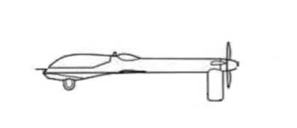
Theory of drone flight – fixed wing
Four forces of flight:
  Lift, Weight, Thrust & Drag
Straight & level flight when forces are balanced
LIFT
THRUST
DRAG
WEIGHT
CENTRE OF GRAVITY
Queensland Group

Slide 44

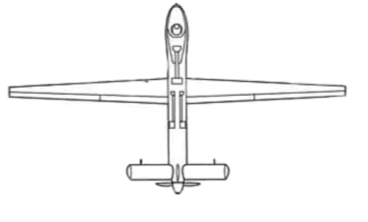
Theory of drone flight – fixed wing
Roll:
  Longitudinal axis
Pitch
  Lateral axis
Yaw
  Normal or vertical axis
Queensland Group

Slide 45
Theory of drone flight – Quadcopter
Use rotors for propulsion & control
Push air down – downwash
Newton’s 3rd law – equal & opposite force
downwash produces LIFT (THRUST)
Faster rotors, more downwash, more lift/thrust
Queensland Group

Slide 46
Theory of drone flight – Quadcopter
Vertical motion
Hover – balanced thrust/weight
Climb – more thrust than weight
Descend – less thrust than weight
Queensland Group

Slide 47
Theory of drone flight – Quadcopter
Horizontal motion – yaw
One pair clockwise (A)
One pair anti-clockwise (B)
Speeds equal = zero angular momentum
Speeds not equal = angular momentum causes rotation/yaw
A
B
B
A
Queensland Group

Slide 48
Theory of drone flight – Quadcopter
Horizontal motion – roll & pitch
Where is the front of a quadcopter?
Queensland Group

Slide 49
Theory of drone flight – Quadcopter
Thrust
Horizontal motion – roll & pitch
Each rotors rotation speed is individually controlled
This causes roll/pitch in a desired direction
Tilts the lift/thrust in that direction
Lift
Direction of motion
Drag
Weight
Queensland Group

Slide 50
What is a Drone?
History of Drones
Uses of Drones
Main parts of a Drone
Theory of Drone flight (fixed wing & multi-rotor)
Drone maintenance
CASA Regulations (Drone flying and Airspace)
Queensland Group

Slide 51
Drone maintenance
Maintenance and storage are very important
  Avoid malfunctions
  Keep you and other safe
Queensland Group

Slide 52
Drone maintenance
General drone maintenance checklist:
Visual inspection
Battery care and storage
Starting and ground running of engines
Propeller maintenance
Transportation
Storage
Queensland Group

Slide 53
Drone maintenance
General drone maintenance checklist:
Visual inspection
  Before power comes on
  Obvious signs of damage
  Outer shell, frame, propellers, landing gear, payload and antenna
  Battery connections
Queensland Group

Slide 54
Drone maintenance
General drone maintenance checklist:
Battery care and storage
  Use a fully charged battery
  Check properly installed (positive & negative)
  Check specific drone battery instructions
  Let battery cool post-flight
  Keep away from wet surfaces / liquids
  Remove battery when finished / for storage
  Store in cool/dry place
Queensland Group

Slide 55
Drone maintenance
General drone maintenance checklist:
Starting and ground running of engines
  Check propellers/battery cables are firm
  Do not start without instructors permission
  Drone will take off quickly once engines running and throttle increased
  Do not start engines until ready to fly
Queensland Group

Slide 56
Drone maintenance
General drone maintenance checklist:
Propeller maintenance
  No cracks, bends or damage
  If any found, replace propellers
  If no spares let your instructor know
Queensland Group

Slide 57
Drone maintenance
General drone maintenance checklist:
Transportation
  Use correct storage containers for transport
  Avoid heat & safety issues discharge battery to 30% prior to transport
  Attach gimbal clamp if appropriate
  May need to recalibrate drones’ compass if long distance travelled.
  Consider removing propellers prior to transport
Queensland Group

Slide 58
Drone maintenance
General drone maintenance checklist:
Storage
  Remove batteries
  Cool dry and non-magnetic location
  Avoid direct sunlight
  Storage at 40-65% battery charge
Queensland Group

Slide 59
What is a Drone?
History of Drones
Uses of Drones
Main parts of a Drone
Theory of Drone flight (fixed wing & multi-rotor)
Drone maintenance
CASA Regulations (Drone flying and Airspace)
Queensland Group

Slide 60
CASA Regulations on Drone flying / Airspace
Regulations are laws – rules for keeping everyone safe in the air and on the ground
WARNING
You must not fly your drone in a way that creates a hazard to another aircraft, person or property, so follow the CASA rules every time you fly.
Queensland Group

Slide 61
CASA Regulations on Drone flying / Airspace
Rules:
You must not fly your drone higher than 120 metres (400 ft) above the ground.
You must not fly your drone over or near an area affecting public safety or where emergency operations are underway (without prior approval). This could include situations such as a car crash, police operations, a fire and associated firefighting efforts, and search and rescue operations.
You must not fly your drone within 30 metres of people, unless the other person is part of controlling or navigating the drone.
You must fly only one drone at a time.
Queensland Group

Slide 62
CASA Regulations on Drone flying / Airspace
Rules continued:
If your drone weighs more than 100 grams:
  You must keep your drone at least 5.5km away from controlled aerodromes (usually those with a control tower)
  You may fly within 5.5km of a non-controlled aerodrome or helicopter landing site (HLS) only if manned aircraft are not operating to or from the aerodrome. If you become aware of manned aircraft operating to or from the aerodrome/ HLS, you must manoeuvre away from the aircraft and land as soon as safely possible. This includes:
    not operating your drone within the airfield boundary (*without approval)
    not operating your drone in the approach and departure paths of the aerodrome (*without approval)
    * Approval is generally linked to an approved model flying association and its members
Queensland Group

Slide 63
CASA Regulations on Drone flying / Airspace
Rules continued:
You must only fly during the day and keep your drone within visual line-of sight.
  This means being able to orientate, navigate and see the aircraft with your own eyes at all times (rather than through a device; for example, through goggles or on a video screen).
You must not fly over or above people. This could include festivals, sporting ovals, populated beaches, parks, busy roads and footpaths.
You must not operate your drone in a way that creates a hazard to another aircraft, person, or property
You must not operate your drone in prohibited or restricted areas.
Please respect personal privacy. Don’t record or photograph people without their consent—this may breach state laws.
Queensland Group

Slide 64
CASA Regulations on Drone flying / Airspace
Tips for flying within the law:
There might be local council and/or national park laws prohibiting drone flights in certain areas.
Research the area you plan to fly and contact your council or national park if you're unsure.
Don't operate near emergency services aircraft – if you fly, they can't.
Flying commercially or for economic gain is illegal, unless you have your remote pilot licence or are flying in the sub-2kg category.
Queensland Group

Slide 65
CASA Regulations on Drone flying / Airspace
Tips for flying within the law:
There might be local council and/or national park laws prohibiting drone flights in certain areas.
Research the area you plan to fly and contact your council or national park if you're unsure.
Don't operate near emergency services aircraft – if you fly, they can't.
Flying commercially or for economic gain is illegal, unless you have your remote pilot licence or are flying in the sub-2kg category.
Queensland Group

Slide 66
CASA Regulations on Drone flying / Airspace
Drone regulations change frequently
In order to remain up to date, check current regulations every six months a www.casa.gov.au
Queensland Group

Slide 67
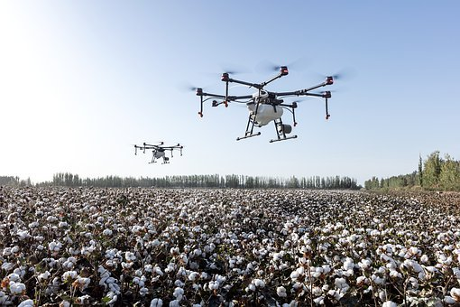
Progress questions

Slide 68
CASA Regulations on Drone flying / Airspace
Best practice tips:
Buying and flying for the first time
  Don’t tear open the box and go flying straight away.
  Flying without first understanding your drone is likely to result in you crashing and destroying your aircraft.
  Read the operating instructions, follow the manufacturer’s guidance and fly in a safe, open location.
Queensland Group

Slide 69
CASA Regulations on Drone flying / Airspace
Best practice tips:
Battery safety
  Batteries can be a hazard if not taken care of
  Look after them and inspect them after every use.
  Whether they’re dropped, smashed or overheated, lithium batteries can become unstable if damaged.
  If your battery shows any signs of leaking, discolouring, bulging or deforming—replace it.
  For more information, go to CASA’s battery safety web page.
Queensland Group

Slide 70
CASA Regulations on Drone flying / Airspace
Best practice tips:
Privacy
  Privacy is an important issue that all drone owners need to think about.
  Rules vary from state to state, but you should always respect personal privacy and not record or photograph anyone without their consent.
  If you are concerned about drones and their implications for privacy, you can contact the Office of the Australian Information Commissioner.
Queensland Group

Slide 71
CASA Regulations on Drone flying / Airspace
Best practice tips:
Whales, dolphins and eagles
  There are certain animals you need to keep your drone away from.
  State-based environmental laws prohibit drones from flying within 300m of marine mammals. Fines can range from $300 to $110,000.
  Birds of prey, such as eagles, hawks and falcons don’t take kindly to a buzzing drone nearby.
  Check the area before take off and land if you see any flying talons nearby. like this one.
Queensland Group

Slide 72
CASA Regulations on Drone flying / Airspace
12 Ways Your Drone Can Land You in Trouble
Flight Safety Australia recently published ‘Dirty Dozen: 12 ways your drone can land you in trouble’. Read the article on Flight Safety Australia and watch the videos.
Queensland Group

Slide 73
Next Steps…
Complete the workbook
Sit the theory exam
Practical training
Practical flight activity/assessment
  Demonstrate and explain safe drone operation
Once competent:
  You have completed AAL Class 3 Drone Air Activities!
Queensland Group

